Slide 1
Project on E-retail factors for customer activation and retention: A case study from Indian e-commerce customers
Salman Pradhan
Submitted by

Slide 2

Required Libraries
1.Numpy
2.Pandas
3.Matplotlib
4.Seaborn
5.Scikit_learn

Slide 3
About Dataset
1.Loading dataset
2.Checking dimension
3.Checking columns
4.Checking column’s type
5.Statistical analysis
6.Checking Null values

Slide 4
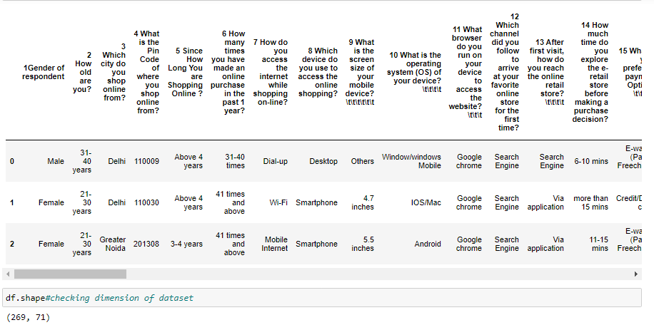
Dataset

Slide 5
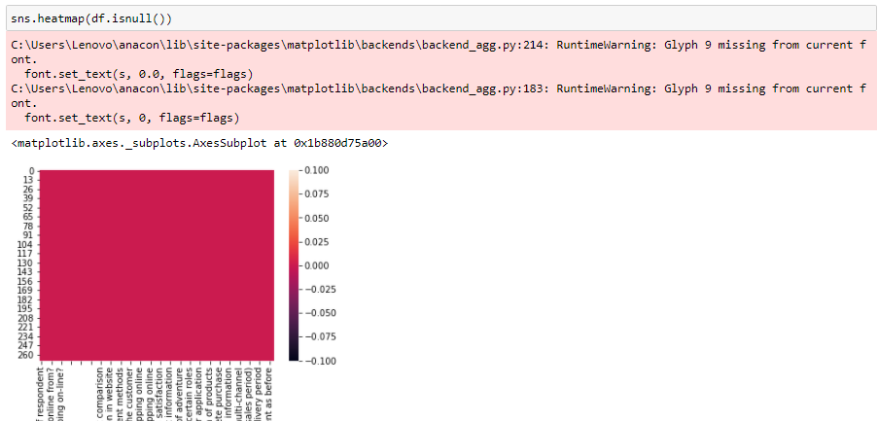
From dataset we get informations as:
Dataset has 269 rows and 71 columns.
Dataset has no null values.

Slide 6
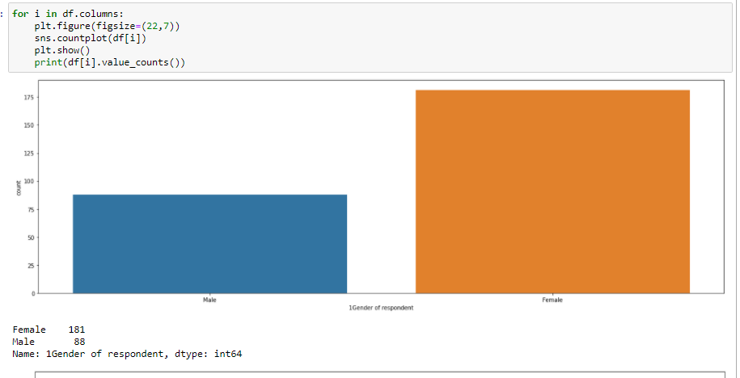
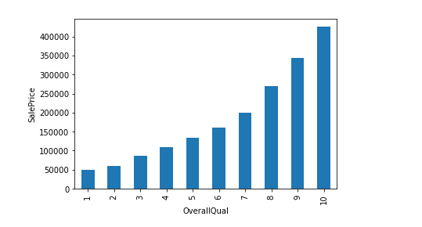
Data Analysis
Total number of male seller are 88 and female seller are 181.

Slide 7
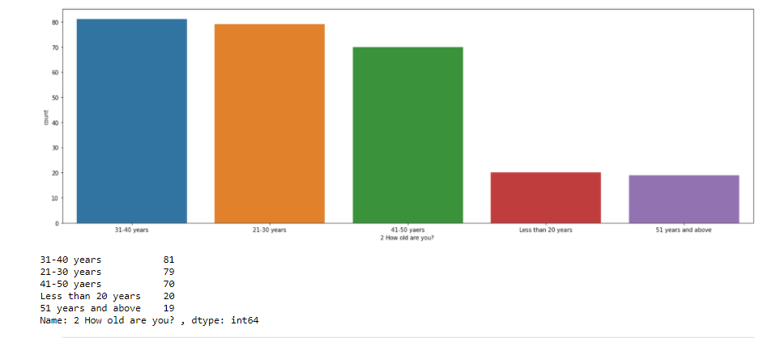
Age between 21 years to 50 year customers loves to shop from online websites or applications.

Slide 8
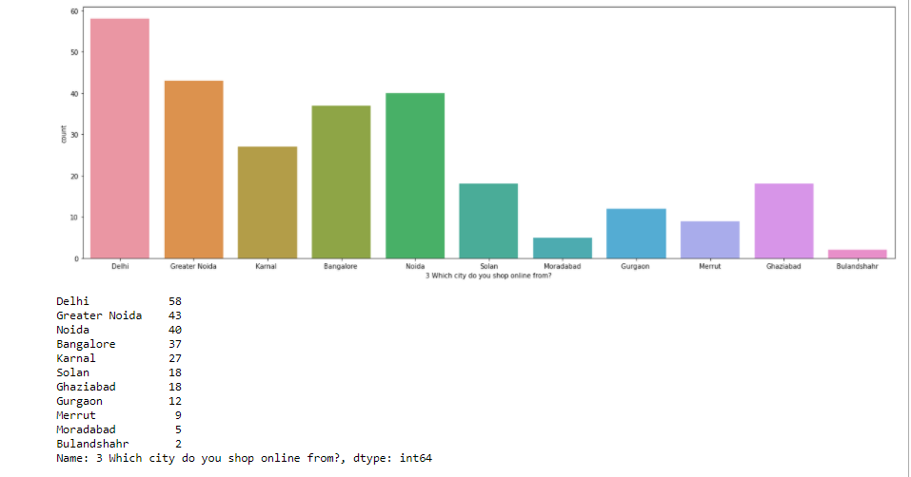
More customers are buying online products from cities like Delhi,GreaterNoida,Noida,Bangalore.

Slide 9
After Visualizations I found that :

Slide 10
According to dataset out of 269 online shoppers 181 are females and 88 are male.
According to dataset out of 269 online shoppers,most shoppers are age between 21-50 years.
According to dataset out of 269 online shoppers,most shoppers shop online from Delhi,Greater Noida,Noida,Bangalore.
According to dataset out of 269 online shoppers,shoppers having pincode 201308 shop more compared to others.
According to dataset out of 269 online shoppers,59 customers have started their shopping from online betwwen 0 to 2 years and
except these 59 customers all are buying from online above 2 years.
According to dataset out of 269 online shoppers,114 shoppers have made their online purchase less than 10 times in the past 1 year.
According to dataset out of 269 online shoppers,189 customers are using mobile internet,76 customers are using wifi and 4 customers are using dial up while shopping online.

Slide 11
According to dataset out of 269 online shoppers,141 of them use smartphone and 86 of them use laptop..
According to dataset out of 269 online shoppers,before making purchase decision 29 of them explore the retail store less than 5minute and remaining 240 persons take more than 5minutes.
According to dataset out of 269 online shoppers,credit/debit and cash on delivery are preffered as best payment option.
According to dataset out of 269 online shoppers,about 90 % of them can easily read and understand the content on website.
According to dataset out of 269 online shoppers,208 shoppers agreed that information on similar product to the one highlighted is important for product comparison.
According to dataset out of 269 online shoppers,188 shoppers agreed that Complete information on listed seller and product being offered is important for purchase decision.
According to dataset out of 269 online shoppers,239 shoppers told that all relevant information on listed products must be stated clearly.
According to dataset out of 269 online shoppers,227 shoppers agreed that Loading and processing speed is important for websites.

Slide 12
According to dataset out of 269 online shoppers,234 shoppers said that websites are user friendly interface.
According to dataset out of 269 online shoppers,236 shoppers said that customer queries are resolved.
According to dataset out of 269 online shoppers,185 shoppers said that 30 online shopping gives monetary benefit and discounts.
According to dataset out of 269 online shoppers,224 shoppers agreed that Shopping online is convenient and flexible.
According to dataset out of 269 online shoppers,92% shpooers agreed that Return and replacement policy of the e-tailer is important for purchase decision.
According to dataset out of 269 online shoppers,almost all shoppers agreed that Displaying quality Information on the website improves satisfaction of customers.

Slide 13
According to dataset out of 269 online shoppers,239 shoppers agreed that user satisfaction cannot exist without trust.
According to dataset out of 269 online shoppers,except 7 shoppers all told that ecommrce site offer a wide variety of listed product in several category.
According to dataset out of 269 online shoppers,except 5 shoppers all told that ecommrce sitehave provision of complete and relevant product information.
According to dataset out of 269 online shoppers,223 shoppers told that it gives monetary benefit while shopping.
According to dataset out of 269 online shoppers,214 shoppers told that shopping on the website gives the sense of adventure.
According to dataset out of 269 online shoppers,almost all are said that getting value for money spent.
According to dataset out of 269 online shoppers,216 of them use google chrome to access the websites

Slide 14
As diagram given to us,we found that Gratification,Role,Best Deal,Social,Adventure,Product offering,Convenience,Product information, and monetary Saving are highly dependent on customer retention.
So we compare all this above with all the online shopping sites individually such as Amazon,Flipkart,Myntra,Snapdeal and paytm where sellers are already shopping(i.e column:’ From the following, tick any (or all) of the online retailers you have shopped from;’).

Slide 15
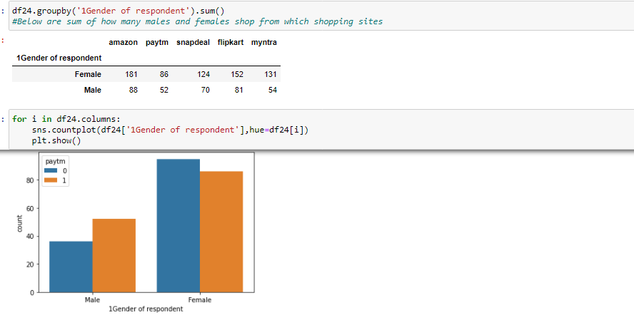
I found that Females are shopping more than males.Both males and females like to shopping from amazon.in than others.

Slide 16
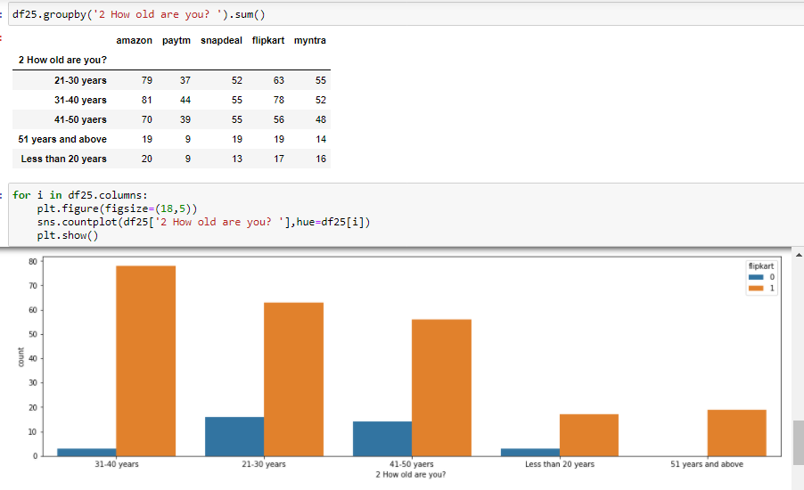
Age between 20-50 years shop more than other age.All age seller prefer Amazon as their first choice then flipkart.com.

Slide 17
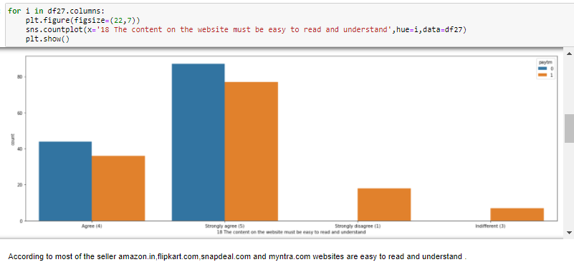

Slide 18
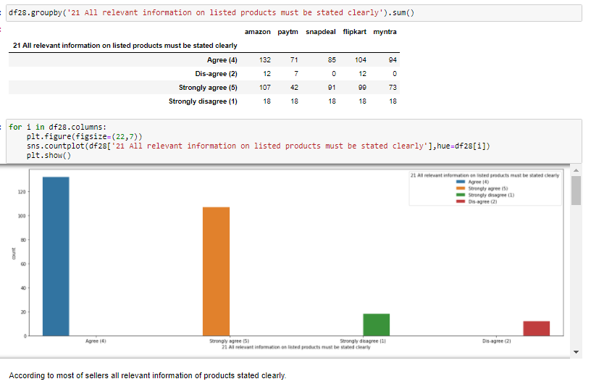

Slide 19
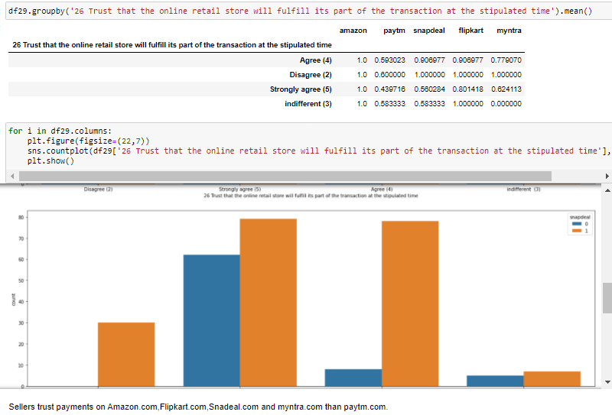

Slide 20
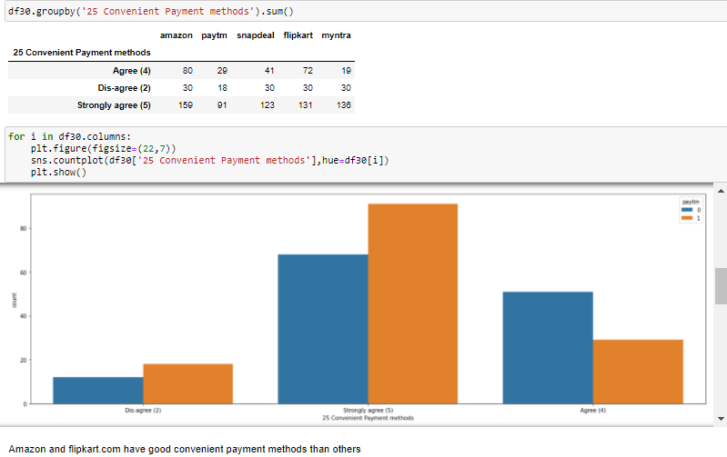

Slide 21
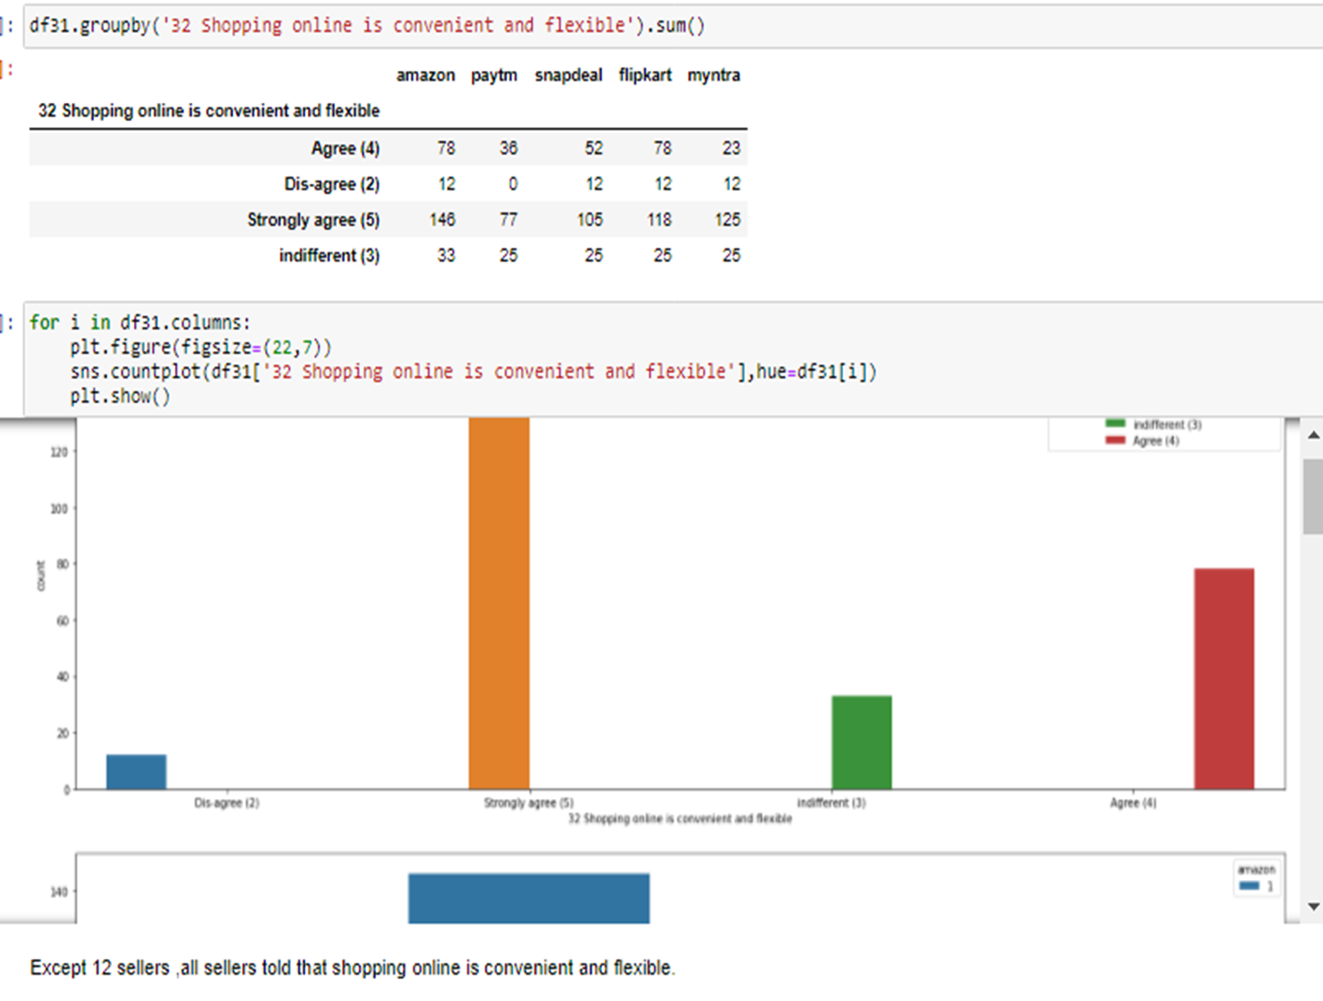

Slide 22
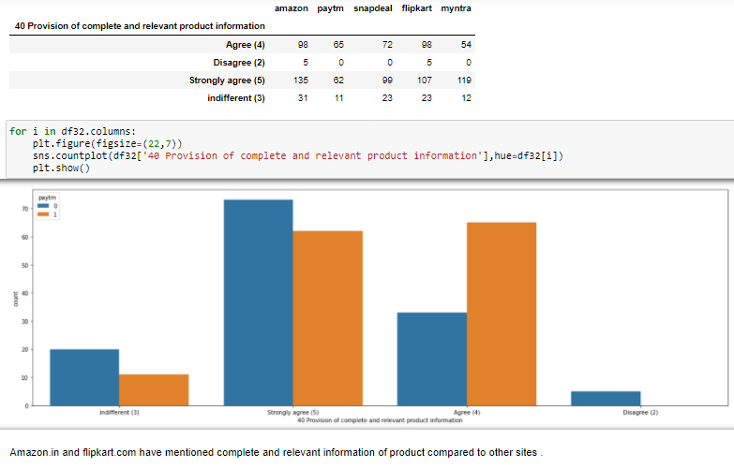

Slide 23
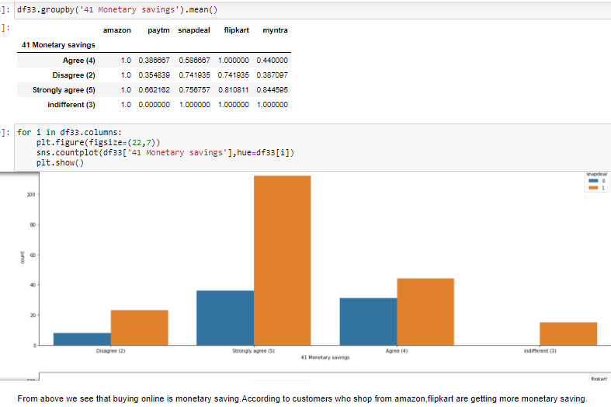

Slide 24
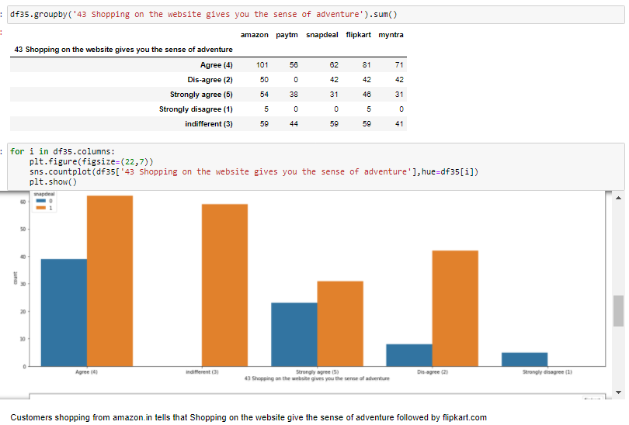

Slide 25
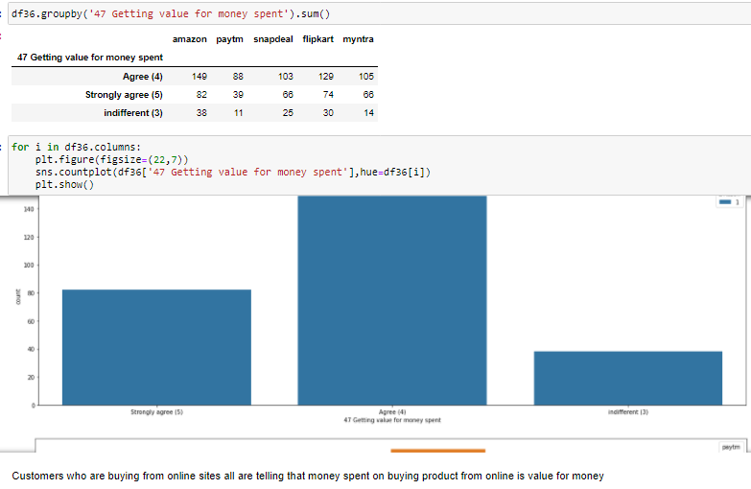

Slide 26
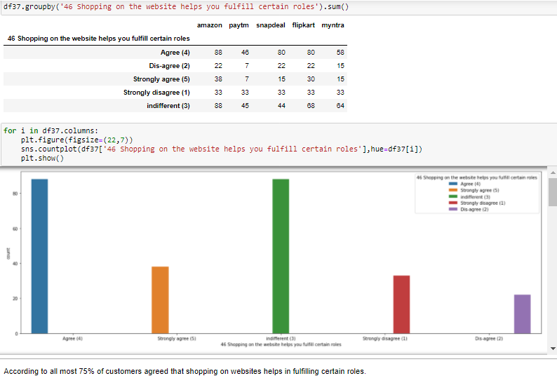

Slide 27
Conclusion
Dataset has 269 rows and 71 columns and there is no null value present.
We know that Gratification,Role,Best Deal,Social,Adventure,Product offering,Convenience,Product information, and monetary Saving are highly corelated with customer retention.So I compare each of them with from where they are shopping individually.
I conclude that
Females are shopping more than males.Both males and females like to shopping from amazon.in than others.
Age between 20-50 years shop more than other age.All age seller prefer Amazon as their first choice then flipkart.com.
Cities like Bulandshahr,Merrut,Moradabad buy smaller amount of things from ecommerce sites and Cities like Delhi,Greater noida,Noida,Bangalore people are shopping more from online websites and all prefer amazon.in for buying something then flipkart.com.
According to most of the seller amazon.in,flipkart.com,snapdeal.com and myntra.com websites are easy to read and understand .
According to most of sellers all relevant information of products stated clearly.
Sellers trust payments on Amazon.com,Flipkart.com,Snadeal.com and myntra.com than paytm.com.
Amazon and flipkart.com have good convenient payment methods than others.
Amazon.in and flipkart.com have mentioned complete and relevant information of product compared to other sites .
Buying online is monetary saving.According to customers who shop from amazon,flipkart are getting more monetary saving.

